Slide 1
Interactive Computer Graphics
Ming Ouhyoung, 歐陽明
Professor,
Dept. of CSIE, and GINM
NTU

Slide 2
Introduction
課號: (50402) 526 U0340
課名: 計算機圖學
英文課名: Interactive Computer Graphics
授課: 歐陽明
Textbook
Interactive Computer Graphics: A Top-Down Approach with WebGL, 作者 Edward Angel, Dave Shreiner, 7th edition, Pearson出版, (開發代理)
Suggested readings
Proceedings of ACM SIGGRAPH Computer Graphics/ACM Trans. On Graphics
IEEE Computer Graphics & Applications (CG&A)
IEEE Trans. on Visualization and Computer Graphics

Slide 3
ICG Syllabus
1. Introduction
1. What is interactive computer graphics, GUI?
2. What is virtual reality, and augmented reality?
3. What is OpenGL/WebGL and shading language?
2. Viewing in 3D and Graphics Programming
1. Parallel projection, Perspective projection etc.
2. First program: Sample codes in WebGL
3. Basic raster graphics algorithms for drawing 3D primitives
1. 3D primitives (Points and Vectors)
2. Geometrics Transformations, Viewing in 3D, 3D clipping
4. Visible-surface determination
1. Z-buffer algorithm
2. Binary space partition trees (BSP)
3. Visible-line determination
5. Illumination and Shading
1. The Phong Reflection Model
2.. Flat shading , Gouraud shading , Phong shading
3. Bilinear interpolation for color and vertex normal interpolation

Slide 4
Syllabus
6. Implementation of a Renderer
Graphics Pipeline: from modeling to display
Implementation by WebGL, Unity3D (game engine)
7. Global rendering--Photo-realistic graphics
1. Recursive ray tracing (光線追蹤法)
2. Volume rendering: (體積顯像法) marching cubes method etc.
3. Radiosity method: (熱輻射法) progressive refinement approach
8. Curves and surfaces: Bezier curves, B-Splines, Spline surfaces
9. Graphics Hardware and Graphics Processing Unit (GPU), GPGPU, APU, Deep Learning Acceleration
10. Implementation and practice
1. Graphics data set
2. How to quickly construct the 3D model data of the world for 3D graphics/AR/VR?
3. Modeling methods and tools
11. Demonstration and Term Projects

Slide 5
Learning experience
Engage Students Immediately with 3D Material: A top-down, programming-oriented approach allows for coverage of engaging 3D material early in the course so students immediately begin to create their own graphics.
Introduce Computer Graphics Programming with WebGL and JavaScript: WebGL is not only fully shader-based– each application must provide at least a vertex shader and a fragment shader–but also a version that works within the latest web browsers.
Create games by example: to modify an existing program in Unity3D, and then create an interesting game/animation of your own.

Slide 6
Grading
Homework: 1/3
Mid-term exam: 1/3
Term project: (1/3) a team with one to three students.
Oral presentation of term project (3 to 5 minutes): a competition graded by all students, with top 1/5 selected as the extra points teams.

Slide 7
Interactive Computer Graphics 2017 TERM PROJECT LISTING
Animation of articulated figures (linked)
Rigid body animation (Newton’s laws)
A viewing system for curved surfaces with textures (curves and patches)
*Two pass or Radiosity method (source codes available)
Ray tracing method for a room / many teapots with different materials (source codes available)
*Volume rendering for a set of tomography slides (台大醫院, 榮總資料 etc.)
Image morphing (2D)

Slide 8
Interactive Computer Graphics 2017 TERM PROJECT LISTING
Sketch system for animation (Teddy system)
Oil painting and water color effects for images
3D morphing and animation with skeleton mapping
Motion retargeting (motion of cats likes that of a human)
Hardware Cg acceleration research and applications
Beautifying Images (Color harmonization, face beautification)
360 Video, Omni-directional stereo video (360 VR video)
Others—Human Computer Interface, VR/AR Apps, Installation Arts, Water Rendering etc.
Reference papers available.
*:considered difficult

Slide 9
Textbook Version Difference
Old version (version 4.0 to 6.0 etc) vs. 7th version (WebGL)
7th version (WebGL): written in JavaScript, Compatible with OpenGL ES2.0 and HTML 5.0
JavaScript Syntax: http://www.w3schools.com/js/js_syntax.asp
Example codes: Index of /~angel/WebGL/7E/02
6th Version:
Use of C++ instead of C
Introduction to Volume Rendering
Compatible with OpenGL3.1

Slide 10
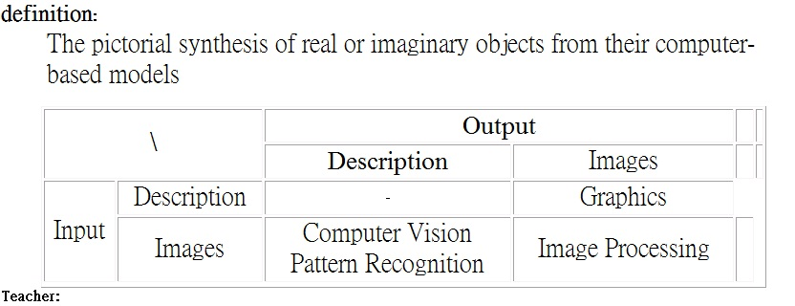
Computer Graphics: vs. Image Processing Computer Vision, Pattern Recognition

Slide 11
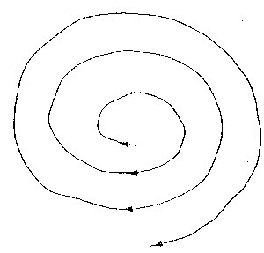
Linear vs. Spiral model in teaching
Chap 1
Chap 2
…
Chap N

Slide 12
The Advantage of Interactive Graphics
One of the most natural means of communicating with a computer.
A picture is worth ten thousand words.
A MOVING picture is worth ten thousand STATIC ones. eg. movie, motion dynamics (flight simulators)
Graphics User Interfaces

Slide 13
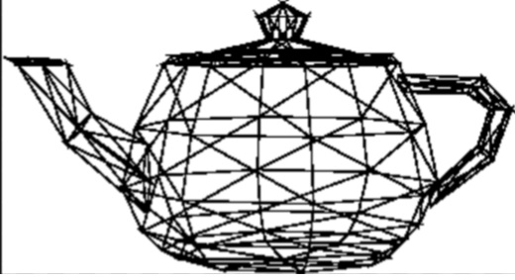
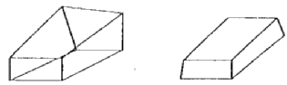
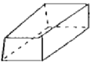
What's wrong with this hand sketched teapot? And a textbook?
A textbook?

Slide 14
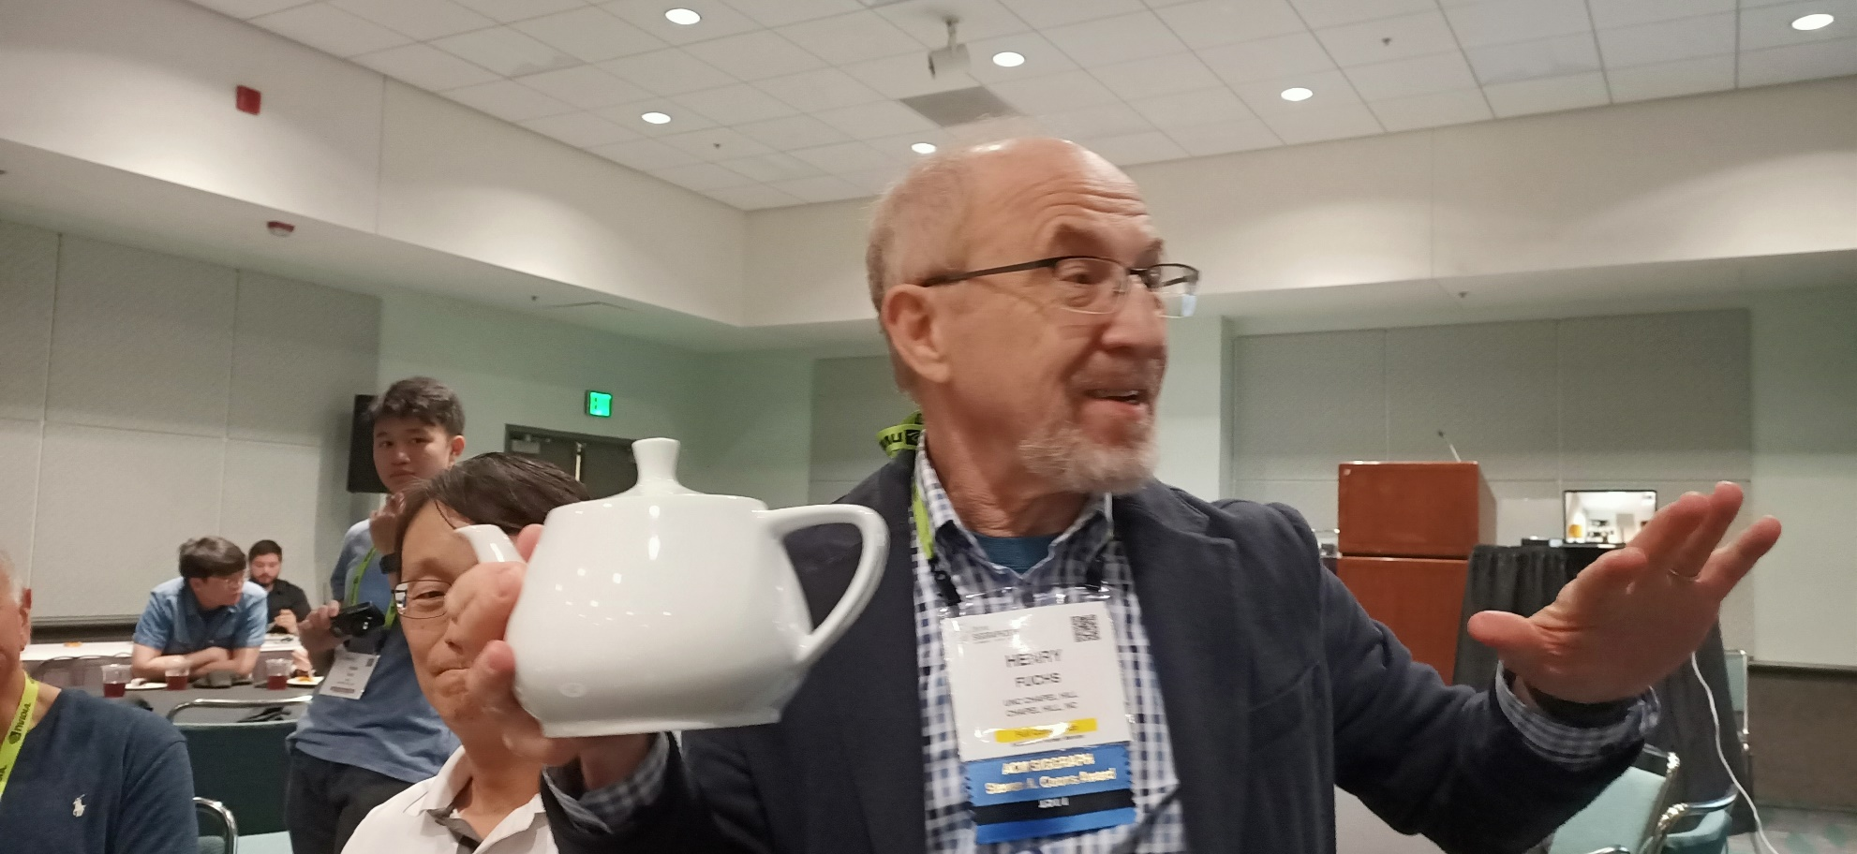
The legendary Utah teapot (UNC professor Henry Fuchs holds the first one)

Slide 15
What's wrong with this teapot?
曲面與塑形 (curved surfaces & modeling)
隱藏面/線 (hidden surfaces / lines)
著色與打光 (shading & lighting)
透視 (perspectives )
材質 (texture )
陶壺 (pottery)，磁壺 (ceramic)，塑膠壺 (plastic)，銅壺 (copper)，紙壺 (paper)
What's the solution? --> research areas in computer graphics

Slide 16

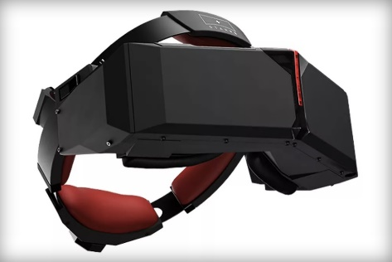
Expected Capabilities
Transformation & Clipping
User Interface design & real time manipulation
A New Car Design
Shading & Lighting/ Curved surfaces
Wire frame, depth cueing, Raster graphics, hidden surface removal
Advanced Illumination:
Ray Tracing, Radiosity, Volume Rendering
GPU programming (OpenGL shading language),
and WebGL
Can do graphics animation, and design for Virtual Reality and Augmented Reality applications

Slide 17
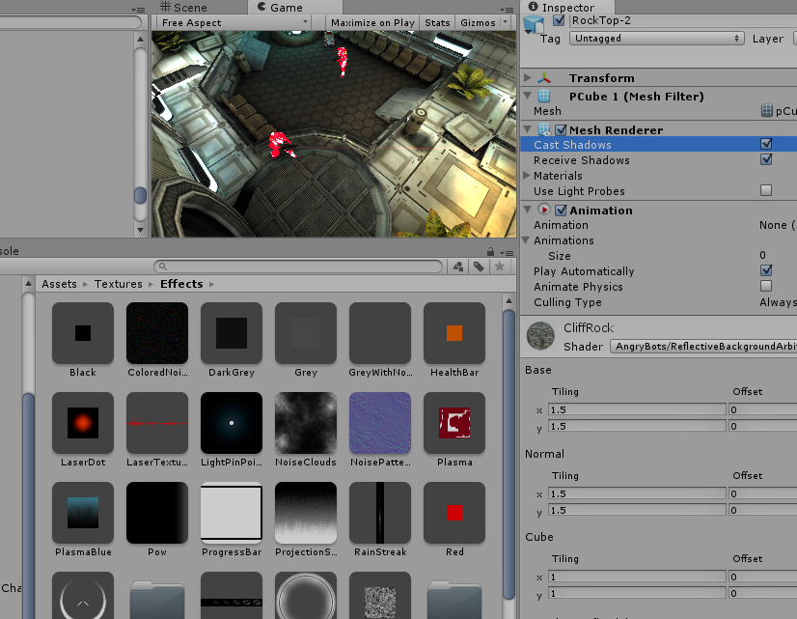
Unity3D: game engine with editors

Slide 18
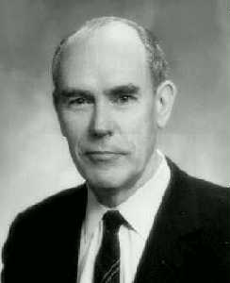
Father of Computer Graphics: Ivan E. Sutherland

Slide 19
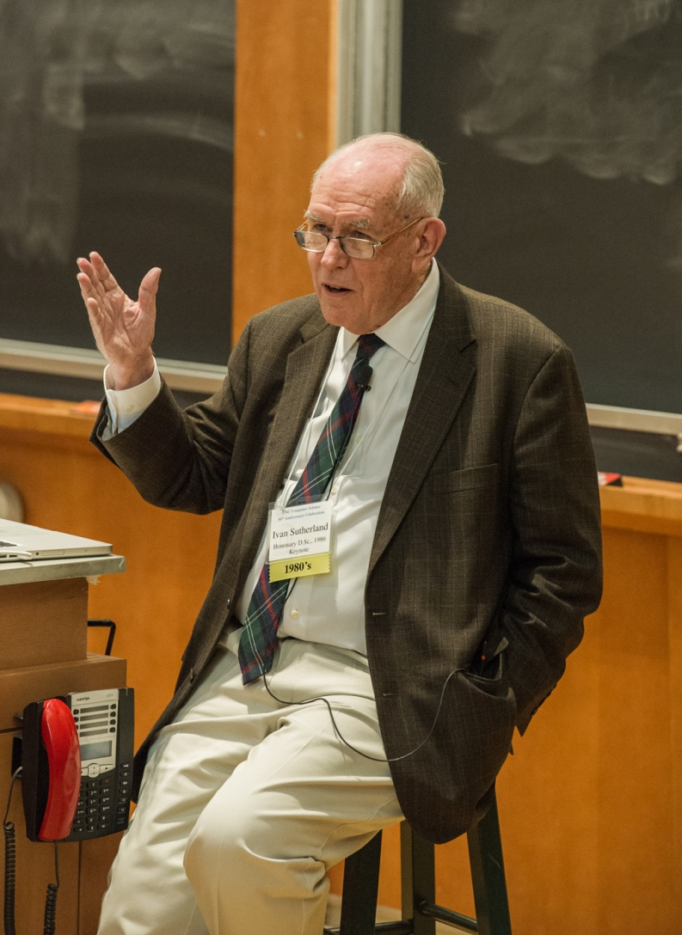
2015/5 speech, at UNC CS 50th celebration

Slide 20
Dr. Ivan E. Sutherland
Ivan Sutherland is considered by many to be the creator of Computer Graphics. Starting with his Ph.D. thesis, Sketchpad, Sutherland has contributed numerous ideas to the study of Computer Graphics and Computer Interaction. Ivan introduced concepts such as 3-D computer modeling, visual simulations, computer aided design (CAD) and virtual reality.
Education
Ph.D., Massachusetts Institute of Technology, 1963;
M.S. EE, California Institute of Technology, 1960;
B.S. EE, Carnegie Institute of Technology (now Carnegie Mellon University), 1959;
Honorary MA, Harvard University, 1966;

Slide 21
Ivan Sutherland, II
Academia Experience
Professor, Harvard University, 1966;
Professor, University of Utah, 1968;
Chairman of Computer Science Department, California Institute of Technology, 1974;
Professional Experience
Electrical Engineer and First Lieutenant, National Security Agency, 1963;
Researcher, Defense Department's Advanced Research Projects Agency, 1964;
Co-Founder, Evans and Sutherland, 1968;
Researcher, RAND Corporation, 1974
Vice-President and Technical Director, Sutherland, Sproull and Associates, 1980;
Vice-President and Sun Fellow, Sun Microsystems, 1990;

Slide 22
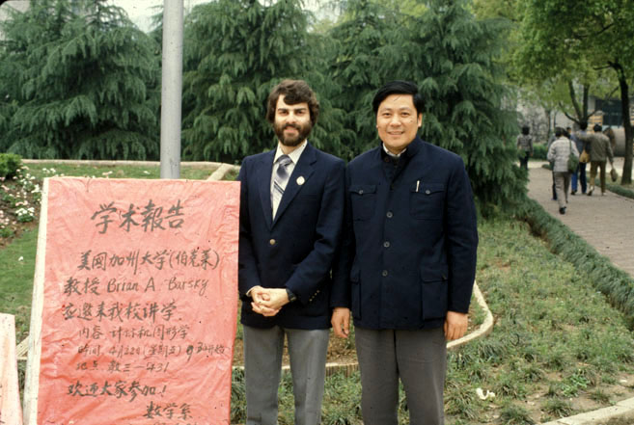


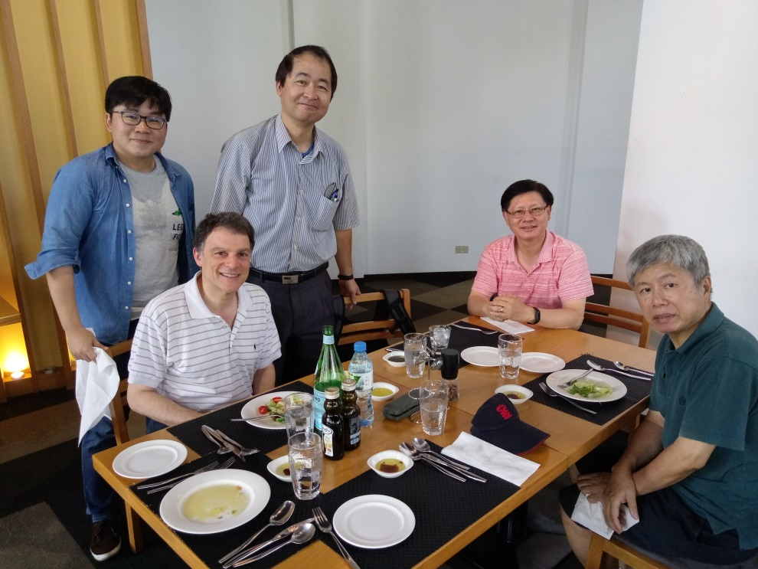
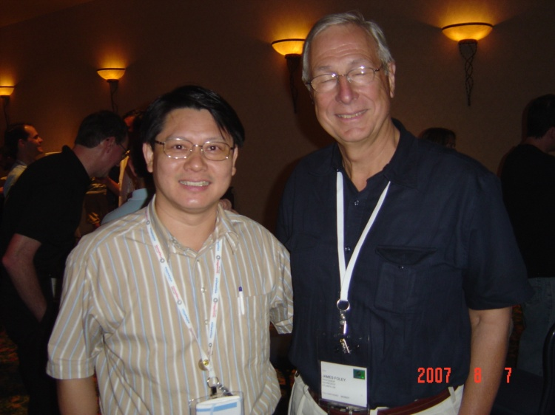
James Foley (lower right, first textbook in CG), Andries Van Dam (upper right, first textbook in CG), Brian Barsky (the rest, line clipping)

Slide 23
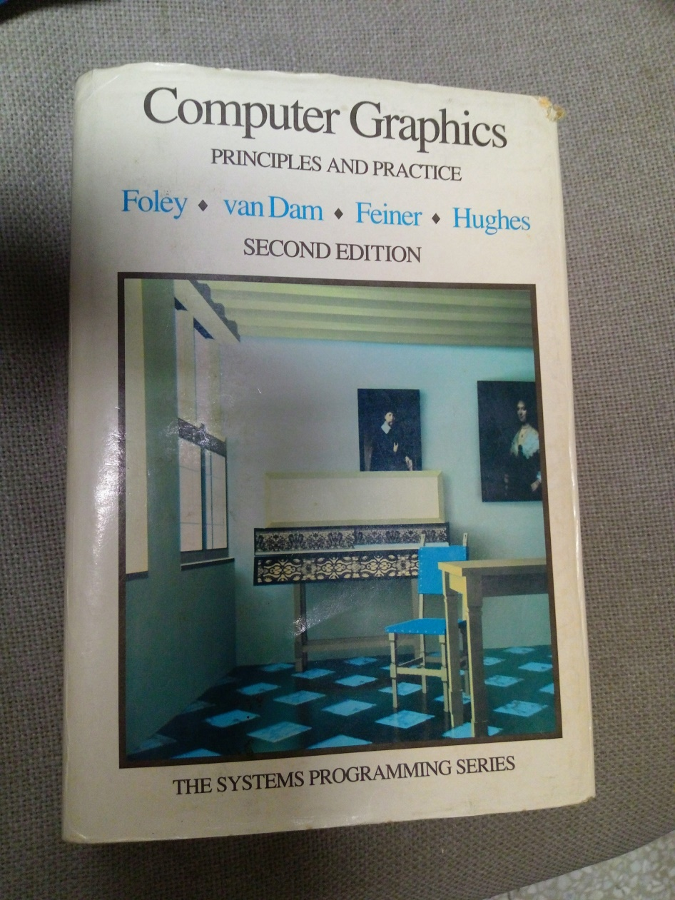
Foley and Van Dam: first popular CG textbook

Slide 24
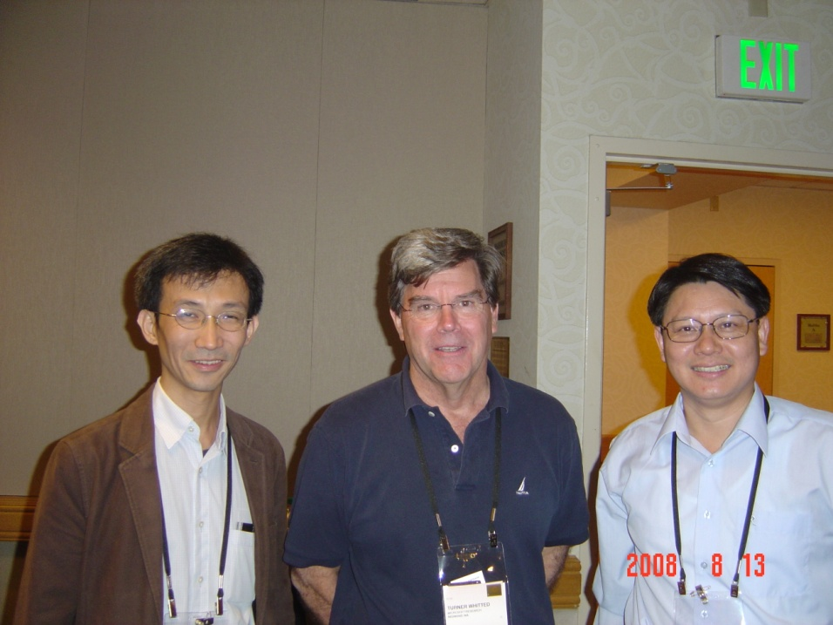
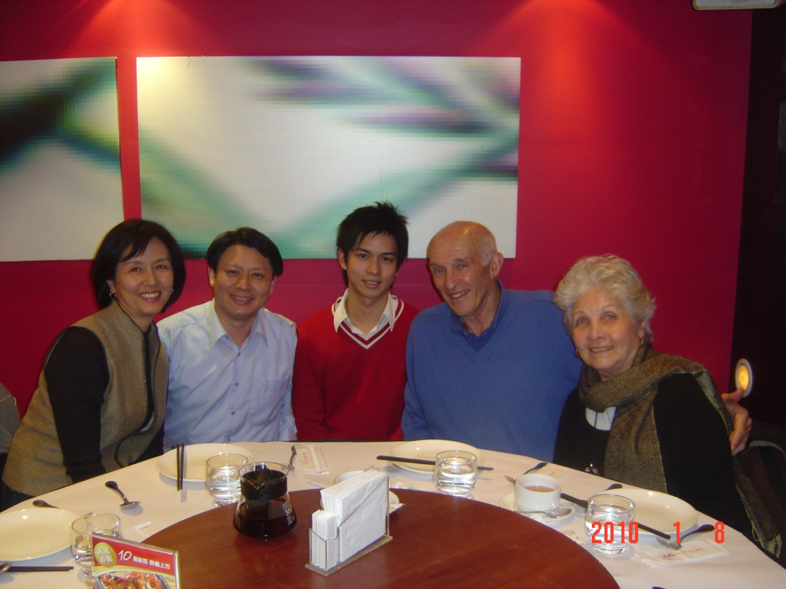
Turner Whitted (upper middle, ray tracing), Donald Greenberg( lower right, radiosity)

Slide 25
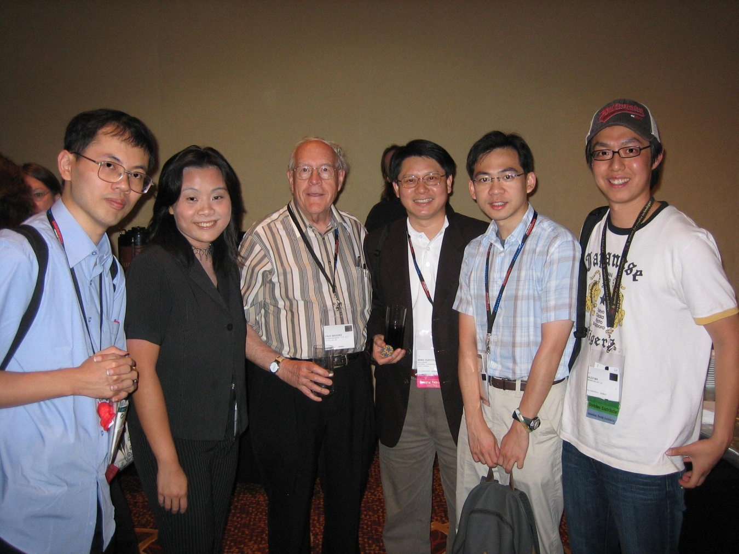
Frederick P. Brooks, Jr. 2006/8 Siggraph (Turing Award 1999, 工程院士, 科學院士, IBM 360/370 chief architect, molecular visualization, 照片右1, 馬萬鈞, Google/Weta Digital, 右二, 林 奕 成, 交大, 左一,葉正聖, 銘傳 )

Slide 26
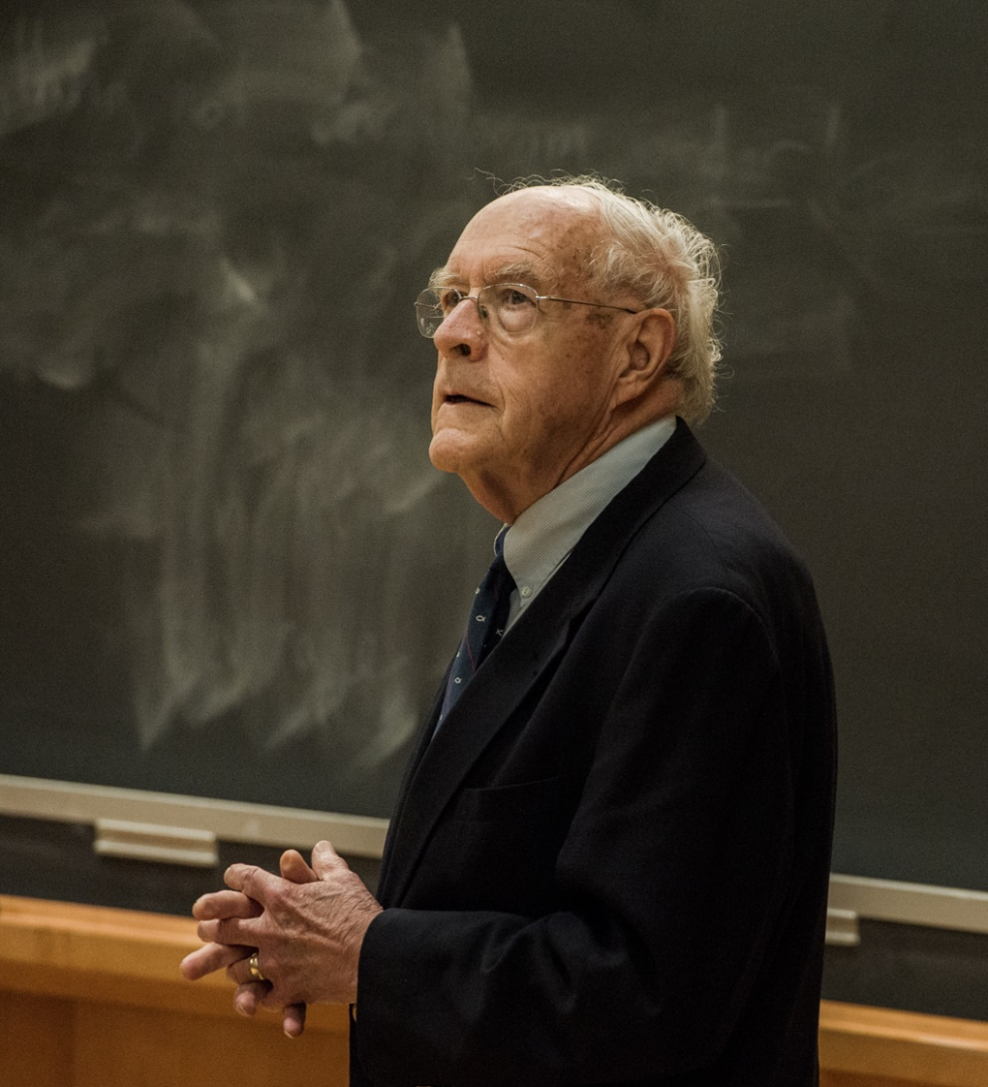
Fred Brooks Jr., 2015/5

Slide 27
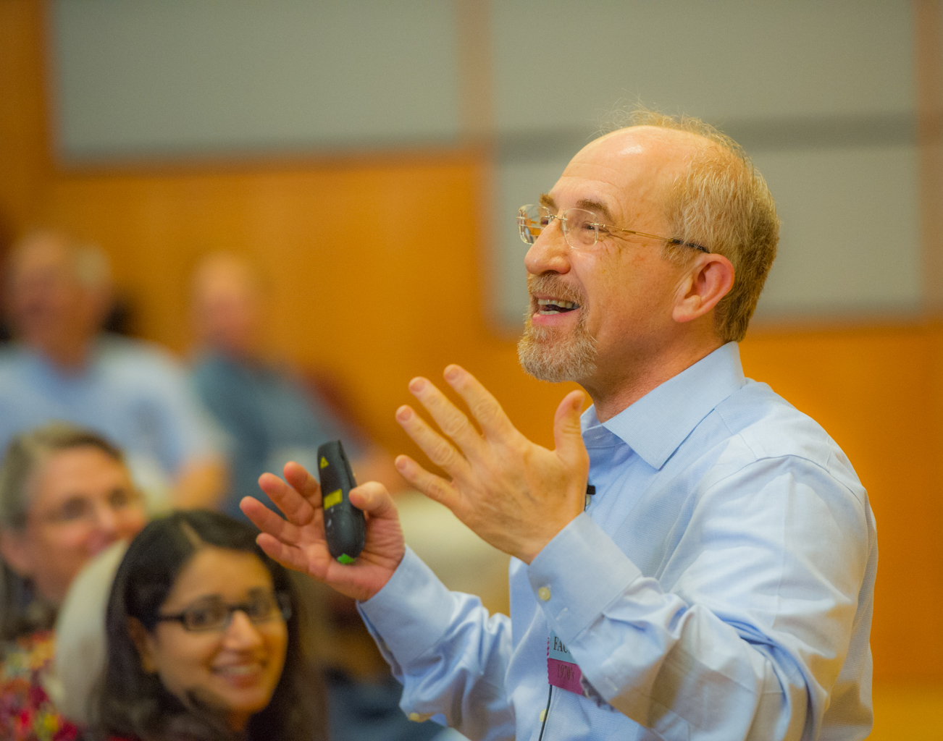
Henry Fuchs, Pixel-Planes 2015/5 Computer Graphics Achievement Award, 1992 member of National Academy of Engineering (美國工程院士)

Slide 28
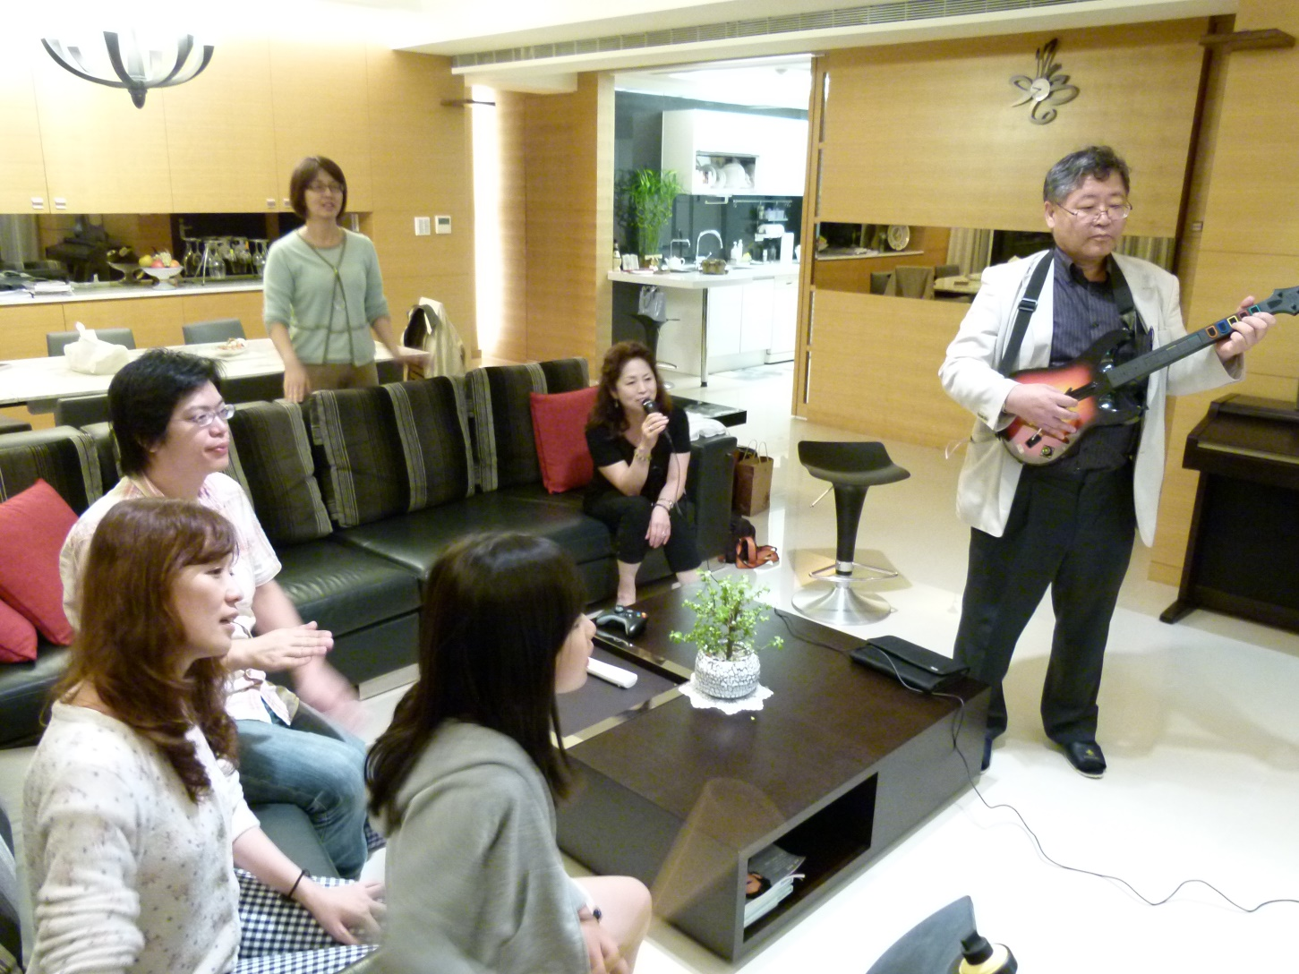
Tomoyuki Nishita, Rendering, 2011/11 Steven Coons Award 2005, major Asian CG researcher

Slide 29
CG Electronic Theater/Animation DEMO
Luxo Jr. (1986 Siggraph, Pixar, The first Oscar 3D Animated short film Academy Award) : demo
The Centrifuge Brain Project (2012): demo
Siggraph Trailer 2017: demo
Siggraph 2016 (Accidents, Blunders and Calamities) : demo
Selected Sigraph Electronic Theater Titles: See my list of the interesting trailers/ titles
Selected Best of Taiwan
1. Early 2D animation: 宏廣 demo (Oscar Academy award)
曾經是全世界最大的單一動畫影片代工廠
2. Cubic Tragedy : demo(台科大)
3. Heavy Duty : demo (太極影音DigiMax Inc.)

Slide 30
Technology DEMO
Mirror system: demo
Da Vinci Surgical System: demo
Realistic Human (Turing test): Emily_Final
Flight simulator : demo
Facial animation: Face_Shift_Ming,
Tracking: ANIM1_LIN_YI_C, TRACK_LIN_YI_C,
Motion capture: Mocap_skating 太極拳
Cloning (Retargeting): demo
Eye surgery simulator: CatAR system: demo

Slide 31
GPU
In the fourth quarter of 2008, 38.5 million desktops shipped, and 15.2 million discrete GPUs were sold, meaning that almost 40 percent of desktops shipped with discrete GPUs.
The GPU market has been doing very well despite the economic turmoil. “an annual increase of 22.5 percent and a quarter to-quarter increase of almost 18 percent.” (2008)
According to the report, this quarter, the three giant chipmakers are holding 97.8 percent of the market share, with Intel at 49.4 percent, Nvidia at 27.8 percent, and AMD at 20.6 percent.
Finally, both major CPU vendors plan to offer, well in advance of 2012, CPUs with onboard GPUs.
Reference sites: http://3dshaders.com

Slide 32
OpenGL history
OpenGL 1.0
(1993) fixed-function configurable pipeline
OpenGL 2.0
(9/2004) open up the processing pipeline for user control by providing programmability for both vertex processing and fragment processing.
OpenGL 3.0
(8/2008)portions of OpenGL were marked “deprecated”, setting the stage for further streamlined specifications.

Slide 33
RenderMan Shading Language and OpenGL Shading Language
Pixar published RenderMan in 1988,
RenderMan shading language is similar to OpenGL Shading Language
RenderMan is similar to OpenGL
OpenGL shading language closely maps to today’s commercial graphics hardware
RenderMan have been typically software based.
OpenGL Shading Language can be thought of as a descendant of the RenderMan shading language

Slide 34
Interface variables to a shader
Uniform qualifiers:
Uniform: changes less frequently,
Specified outside of a shader
In qualifiers:
In: input interface for a shader,
Frequently modified data
Out qualifiers:
Out: The vertex shader writes the per-vertex values to be interpolated to an OUT variable.

Slide 35
GPU introduction
See my document page103_UBC_GPU

Slide 36
DEMO: GPU shader and SIGGRAPH animation from Taiwan
See my speech slide
IPO of Alibaba Inc., and its impact on Taiwan
IT companies.

Slide 37
Definition
Pixel:
a screen consists of N x M pixels
Image Frame Buffer:
an array of data in memory mapped to screen
Color:
RGB model:
Indexed color, 8 bit/pixel: 256 colors
Reduced color, 16 bit/pixel: R 5 bits, G 5 bits, B 5 bits, 1 bit overlay
True color, 24 bit/pixel: R,G,B each 8 bit - 32 bit/pixel, including transparency, light source etc.
Dithering (抖動著色)
(using 2⁸ colors to approximate 2¹⁶ colors)
halftone approximation: 網點著色
also called clustered-dot Ordered dither

Slide 38
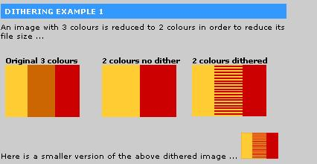
Dithering

Slide 39
Human Factors
Visual acuity: eye’s ability to distinguish two points of light is limited to 1.5 – 2.0 mm at a distance of 10 meters. (or 2 microns on the retina)
Sound: at 0 degree Celsius, travels at 331 meters per second
Hearing range for a young healthy person, 20Hz to 20KHz
Tactile: (receptors, Pacinian corpuscles) respond to frequencies 30-700Hz
PS: Pacinian corpuscles(感覺神經末梢一種層狀囊包)

Slide 40
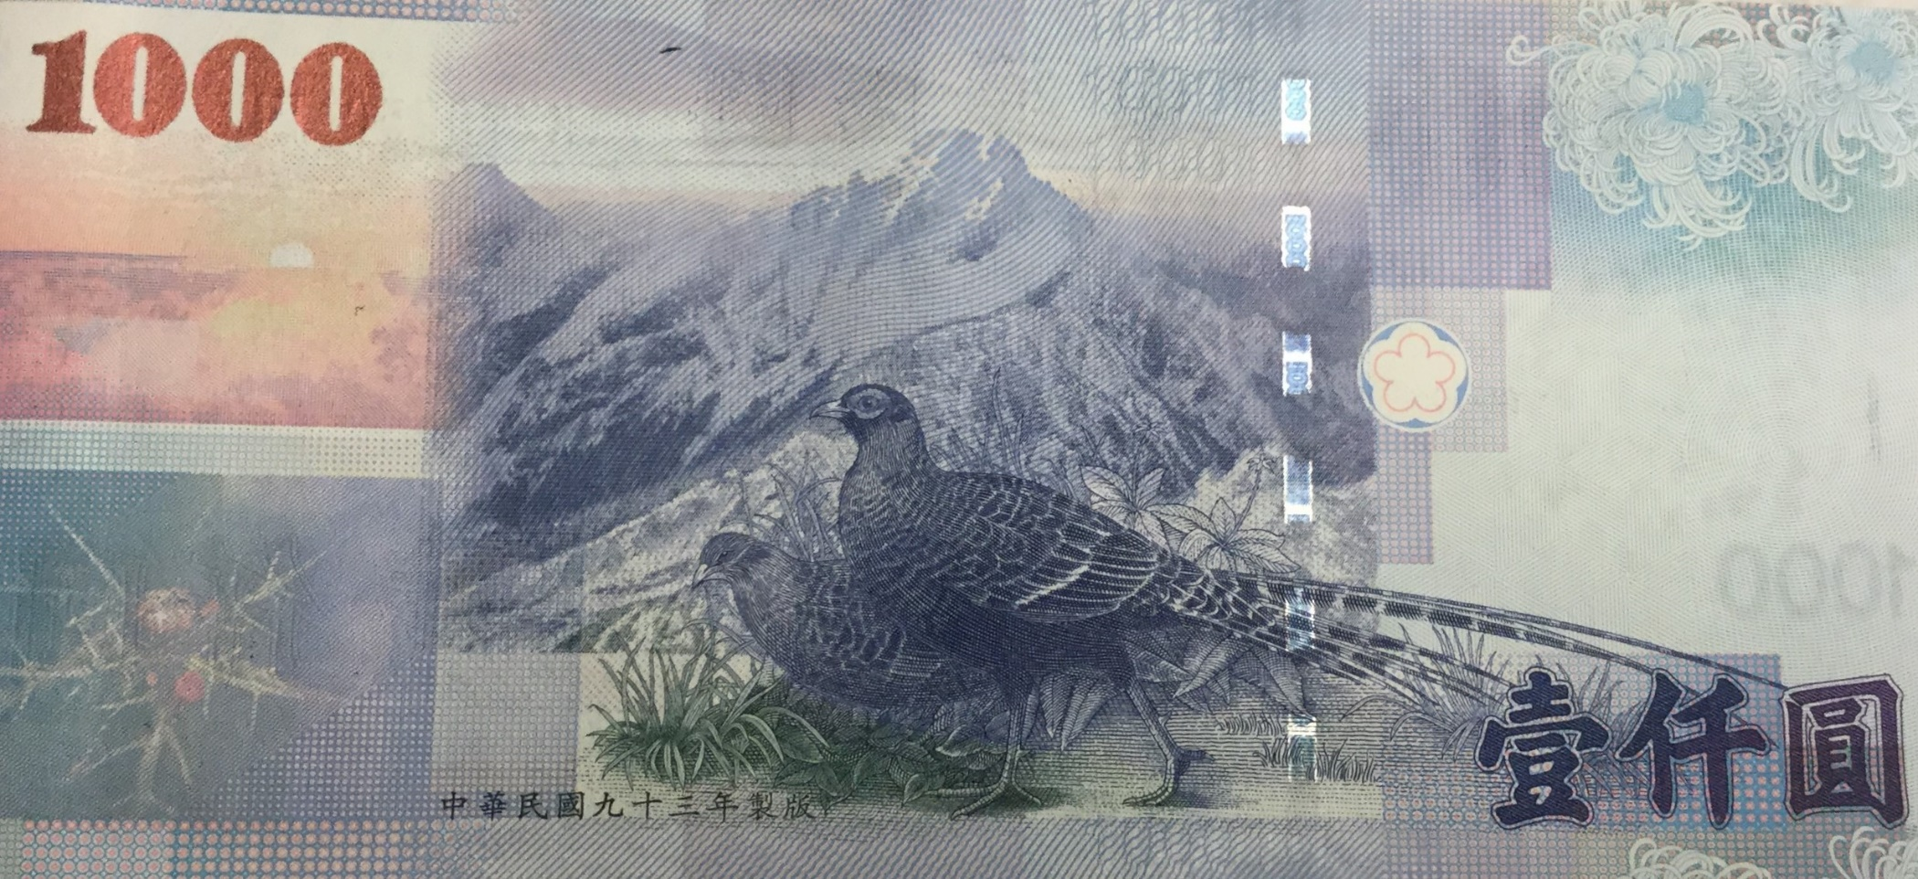
1000 元 鈔票 背面 動物 台灣帝雉、黑長尾雉

Slide 41
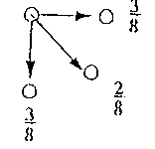
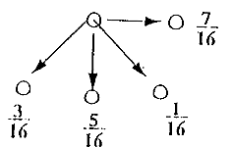
(Floyd-Steinberg) Error Diffusion Dithering
Error diffusion pattern:

Slide 42
Error Diffusion Dithering: example
How to approximate such an array if we have elements of the form 2xN only? (i.e. 0,2,4,6,8,10, etc.) (initial approximation
by lower bound)
error
intermediate calculation

Slide 43
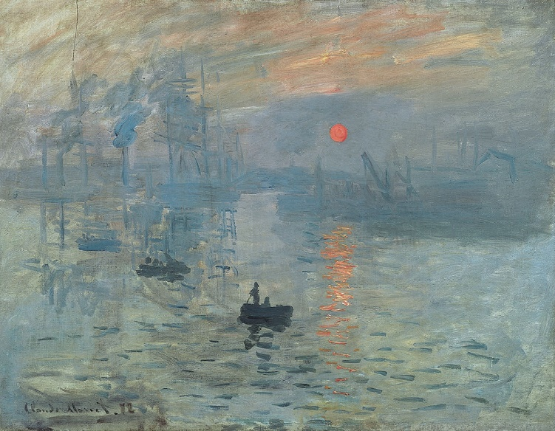
Impressionism
Impressionist painting characteristics include relatively small, thin, yet visible brush strokes,

Slide 44
Geometrical Transformation
Why homogeneous coordinate system?
Translation
P'=T + P ...... (I)
Scaling
P'=S x P ...... (II)
Rotation
P'=R x P ......(III)
T : translation matrix
S : scaling matrix
R : rotation matrix
(II) & (III) are multiplications

Slide 45
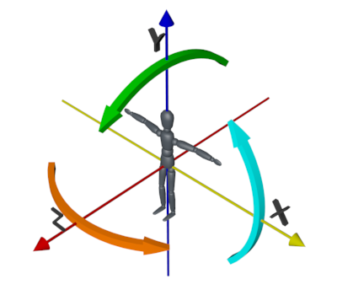
3D Rotation & Translation

Slide 46
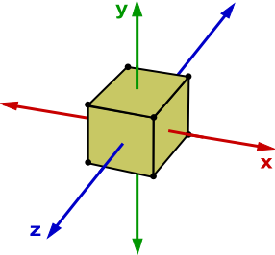
Rotation axis: X, Y, Z

Slide 47
Geometrical Transformation
To be able to compose transformations, each point (x,y,z) is represented by (x,y,z,w) where w is usually 1. So, translation becomes

Slide 48
3D rotation

Slide 49
3D Translation & Scaling
Translation
Scaling

Slide 50
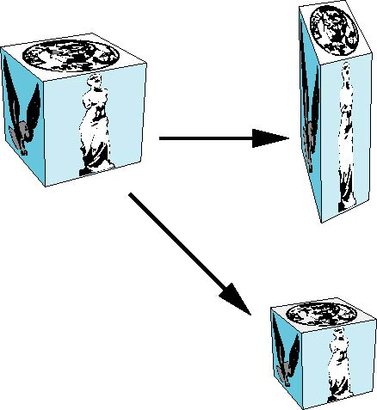
Scaling
Expand or contract along each axis (fixed point of origin)
x’=s_{x}x
y’=s_{y}y
z’=s_{z}z
p’=Sp
S = S(s_{x}, s_{y}, s_{z}) =

Slide 51
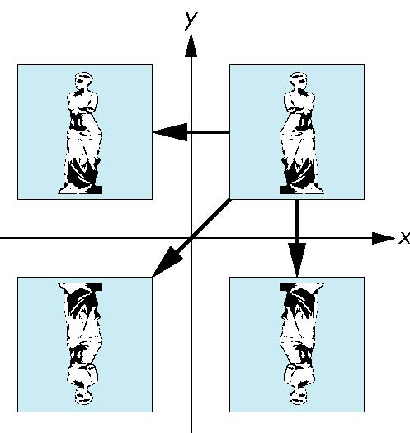
Reflection
corresponds to negative scale factors
s_{x} = -1 s_{y} = 1
original
s_{x} = -1 s_{y} = -1
s_{x} = 1 s_{y} = -1

Slide 52
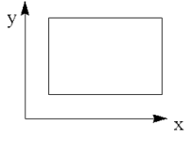
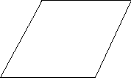
More on Geometrical Transformations
Affine transformation
preserving parallelism of lines, but not lengths and angles.
Rotation, translation, scaling and shear transformations are affine.
Shear (剪力)

Slide 53
3D shear

Slide 54
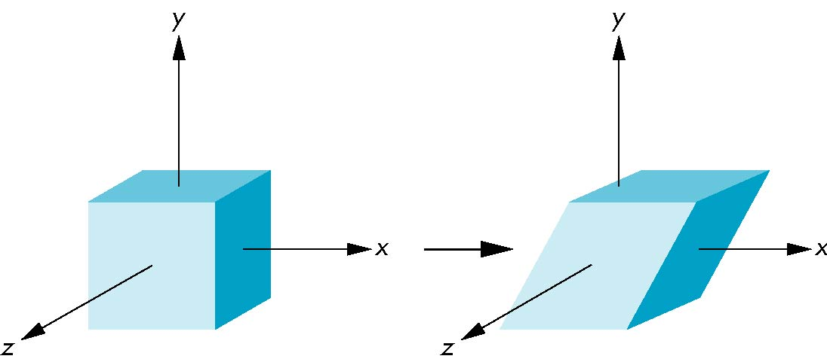
Shear
Helpful to add one more basic transformation
Equivalent to pulling faces in opposite directions

Slide 55
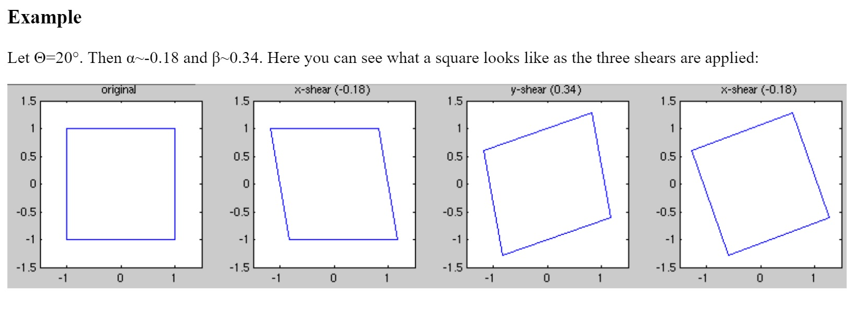
Rotation by shearing, a 2D example

Slide 56
Transformation Matrix
Any number of rotating, scaling, and transition can be multiplied together!
Post-multiplication vs. pre-multiplication

Slide 57
Concatenation of transformations
Let
In OpenGL, the syntax are
The Rule in OpenGL/WebGL:
The transformation specified most recently is the one applied first
Transformation | OpenGL Syntax | Examples
Rotation | glRotatef(angle, vx, vy, vz) | glRotatef(45.0, 1.0, 0.0, 0.0)
Translation | glTranslatef(dx, dy, dz) | glTranslatef(-4.0, -5.0, -6.0)
Scaling | glScalef(sx, sy, sz) | glScalef(2.0, 1.0, 1.0)

Slide 58
Transformations: the syntax in WebGL are
Var a = rotate (angle, direction)
Var b = rotateX(angle) angle: in degrees
Var e = scale(scaleVector)
Var f = translate(translateVector)
a, b, e, f: matrix type
Rotations are around a fixed point at the origin.

Slide 59
Concatenation
We can form arbitrary affine transformation matrices by multiplying together rotation, translation, and scaling matrices
Because the same transformation is applied to many vertices, the cost of forming a matrix M=ABCD is not significant compared to the cost of computing Mp for many vertices p
The difficult part is how to form a desired transformation from the specifications in the application

Slide 60
Objectives
Learn how to carry out transformations in WebGL
Rotation
Translation
Scaling
Introduce MV.js transformations
Model-view
Projection

Slide 61
Current Transformation Matrix (CTM)
Conceptually there is a 4 x 4 homogeneous coordinate matrix, the current transformation matrix (CTM) that is part of the state and is applied to all vertices that pass down the pipeline
The CTM is defined in the user program and loaded into a transformation unit
C
p
p’=Cp
vertices
CTM
vertices

Slide 62
CTM operations
The CTM can be altered either by loading a new CTM or by postmutiplication
Load an identity matrix: C ← I
Load an arbitrary matrix: C ← M
Load a translation matrix: C ← T
Load a rotation matrix: C ← R
Load a scaling matrix: C ← S
Postmultiply by an arbitrary matrix: C ← CM
Postmultiply by a translation matrix: C ← CT
Postmultiply by a rotation matrix: C ← C R
Postmultiply by a scaling matrix: C ← C S

Slide 63
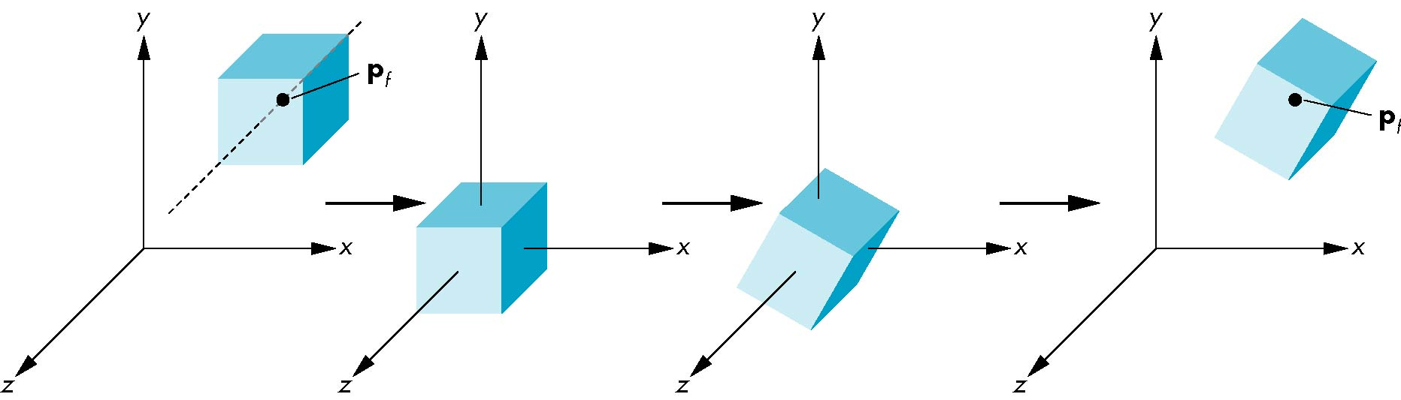
Rotation About a Fixed Point other than the Origin
Move fixed point to origin
Rotate
Move fixed point back
M = T(p_{f}) R(θ) T(-p_{f})

Slide 64
Reversing the Order
We want C = T ^{–1} R T
so we must do the operations in the following order
C ← I
C ← CT ⁻¹
C ← CR
C ← CT
Each operation corresponds to one function call in the program.
Note that the last operation specified is the first executed in the program

Slide 65
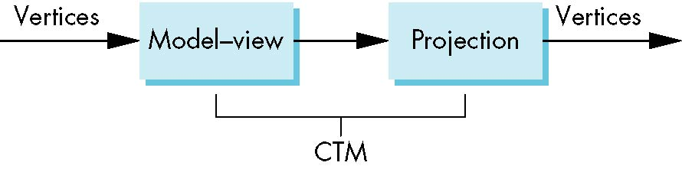
CTM in WebGL
OpenGL had a model-view and a projection matrix in the pipeline which were concatenated together to form the CTM
We will emulate this process

Slide 66
Using the ModelView Matrix
In WebGL, the model-view matrix is used to
Position the camera
Can be done by rotations and translations but is often easier to use the lookAt function in MV.js
Build models of objects
The projection matrix is used to define the view volume and to select a camera lens
Although these matrices are no longer part of the OpenGL state, it is usually a good strategy to create them in our own applications
q = P*MV*p

Slide 67
Rotation, Translation, Scaling
Create an identity matrix:
var m = mat4();
Multiply on right by rotation matrix of theta in degrees
where (vx, vy, vz) define axis of rotation
var r = rotate(theta, vx, vy, vz)
m = mult(m, r);
Also have rotateX, rotateY, rotateZ
Do same with translation and scaling:
var s = scale( sx, sy, sz)
var t = translate(dx, dy, dz);
m = mult(s, t);

Slide 68
Example
Rotation about z axis by 30 degrees with a fixed point of (1.0, 2.0, 3.0)
Remember that last matrix specified in the program is the first applied
var m = mult(translate(1.0, 2.0, 3.0),
rotate(30.0, 0.0, 0.0, 1.0));
m = mult(m, translate(-1.0, -2.0, -3.0));

Slide 69
Rotation About a Fixed Point other than the Origin
Move fixed point to origin
Rotate
Move fixed point back
M = T(p_{f}) R(θ) T(-p_{f})

Slide 70
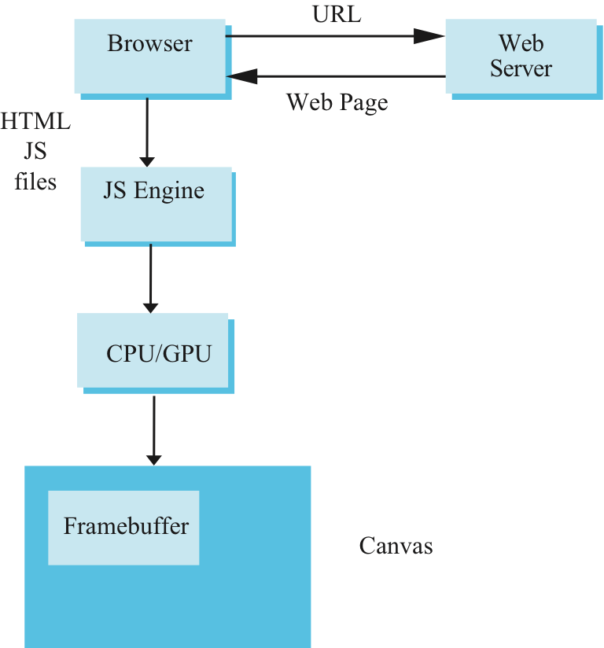
Execution in Browser

Slide 71
Home demo: WebGL
Homework demo provided by our TA
DEMO
Homework demo by previous students
DEMO1
DEMO2

Slide 72
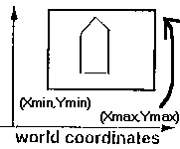
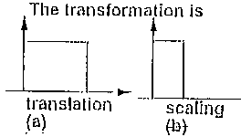
The Window-to-Viewport transformation
World coordinate v.s. Screen coordinate

Slide 73
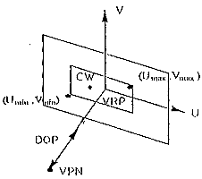
Viewing in 3D
CW:
Center of the window
VRP:
View Reference Point
VPN:
View-Plane Normal
DOP:
Direction of Projection

Slide 74
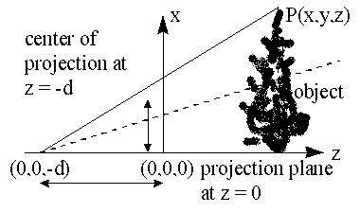
Viewing in 3D (eye at 0,0,-d)

Slide 75
Viewing in 3D: in matrix form

Slide 76
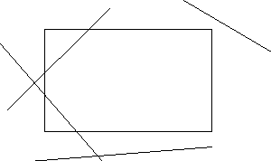
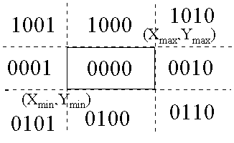
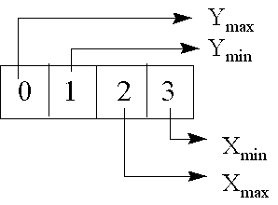
Clipping Lines (see building walkthrough video)
Why clipping? inside building, closer view
Cohen-Sutherland Line - Clipping algorithm
Trivial rejection:
if logical AND of the codes of the endpoints is not zero
New segments created:
replacement by intersection point

Slide 77
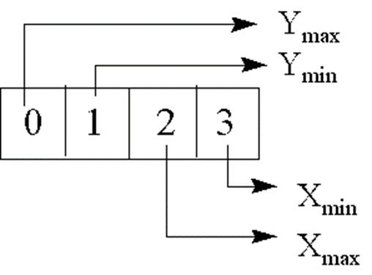
Clipping Lines, line U = (A, B) to (C,D)
Conditions to set a bit to 1,
when input value A is:
Larger than Xmax
Smaller than Xmin,
when input value B is
Larger than Ymax
Smaller than Ymin,

Slide 78
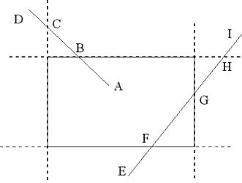
Clipping line: calculate intersection points

Slide 79
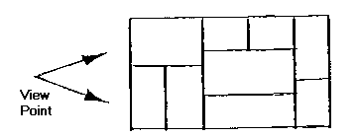
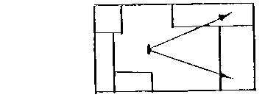
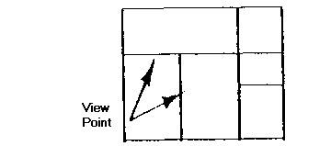
Clipping of 3D polygons (see 3D clipping powerpoint)
Scissoring ----> draw only those lying within the rasterized clip region
Practical: If we are within a building with many rooms, how to reduce the polygons to be processed? (video)

Slide 80
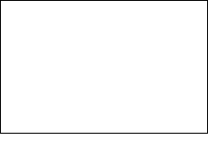
Animation: double buffer
If left ready, then show left, draw right buffer now therefore, no flickering

Slide 81
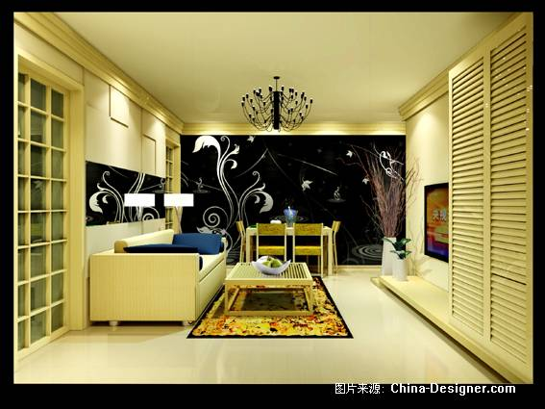

One Point Perspective VS. Two Point Perspective VS. Three Point Perspective Perspective projections are categorized by their number of principal vanishing points. --> Number of axes the projection plane cuts

Slide 82

Two Point Perspective

Slide 83



Two-point perspective

Slide 84

Moving Point Perspective(北宋, 張擇端, 見DEMO)

Slide 85
Aseem Agarwala. Maneesh Agrawala, Michael Cohen, David Salesin, Richard Szeliski, “Photographing Long Scenes with Multi-Viewpoint Panoramas”, SIGGRAPH 2006

Slide 86

One example

Slide 87
Ordinary pictures are 3 point perspectives.

Slide 88
New graphics programming: WebGL self-learning
How?

Slide 89
WebGL demo and codes
Using Google to search for the key words: “WebGL experiments”
Chrome WebGL experiments
Run on your Android/iOS phones, iPad, Windows NB etc. using native browser, or Chrome.
Try “newest” selections ➔ Jelly fish
Try “oldest” selection -> Field (1000 grass blades blowing by wind). Speed measurements: iPad Air plus, is running at 30 frames while my Android smartphone HTC M8x is running at 20 frames per second.

Slide 90
Source codes
Learning WebGL (WebGL lessons, Tony Parisi editor in chief )
It also has Chinese version!
DEMO of WebGL codes for homework 1
https://www.csie.ntu.edu.tw/~ming/courses/icg/WebGL_DEMO/DEMO1/
https://www.csie.ntu.edu.tw/~ming/courses/icg/WebGL_DEMO/DEMO2/
https://www.csie.ntu.edu.tw/~ming/courses/icg/WebGL_DEMO/DEMO3/

Slide 91
Starting point: Simple triangles
Triangle vertex1_X vertex1_Y vertex1_Z normal1_X normal1_Y normal1_Z vertex2_X vertex2_Y vertex2_Z normal2_X normal2_Y normal2_Z vertex3_X vertex3_Y vertex3_Z normal3_X normal3_Y normal3_Z

Slide 92
COLOR
Triangle frontcolor_R frontcolor_G frontcolor_B backcolor_R backcolor_G backcolor_B vertex1_X vertex1_Y vertex1_Z normal1_X normal1_Y normal1_Z vertex2_X vertex2_Y vertex2_Z normal2_X normal2_Y normal2_Z vertex3_X vertex3_Y vertex3_Z normal3_X normal3_Y normal3_Z

Slide 93
One real example
COLOR
Triangle 255 255 255 250 0 0 595.000000 453.000000 40.000000 0.000000 1.000000 0.000000 482.000000 453.000000 0.000000 0.000000 1.000000 0.000000 482.000000 453.000000 40.000000 0.000000 1.000000 0.000000

Slide 94
To save space, Winged Edge Representation
In computer graphics, the winged edge data structure is a way to represent polygon meshes in computer memory. It is a type of boundary representation and describes both the geometry and topology of a model. Three types of records are used: vertex records, edge records, and face records.

Slide 95

Representation

Slide 96

Representation2

Slide 97
How to draw (render) triangles

Slide 98


Slide 99


Slide 100


Slide 101


Slide 102


Slide 103

Standard Graphics Pipeline

Slide 104
Advanced rendering methods that usually cannot be easily implemented by standard graphics pipeline
Ray Tracing (光線追蹤法)
Volume Rendering
Radiosity (熱輻射法)
Photon Mapping

Slide 105


Volume Rendering: result images

Slide 106


Slide 107
What is still missing in ray-traced images?
Diffuse to diffuse reflection?

Slide 108
END part 1

